Slide 2
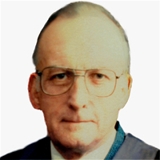

OPENING ADDRESS
EAMONN
O’DWYER

