Slide 2
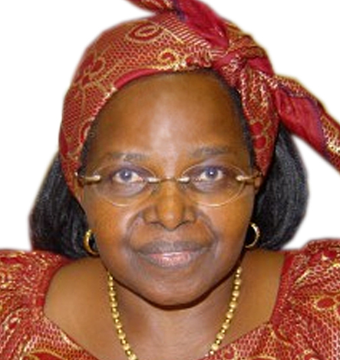
MATERNAL HEALTHCARE
Challenges and Strategies for Low Resource Nations
Jean
Kagia

